Slide 1
Group name : Tempcad
Robotics Term Project
201632314 허승효
201634930 박상우
201634936 백정웅
201635840 이정명

Slide 2
01
Introduction
Project Title
Motivation & Goal
02
System & Architecture
Value
Hardware component
03
Feature
Pros. and Cons.
Special points
04
Final
Progress
Participation

Slide 3
Introduction

Slide 4
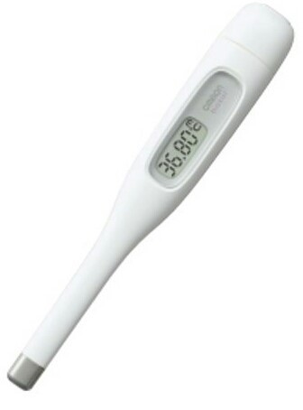
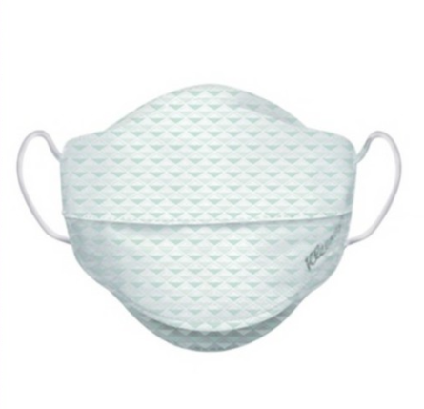

01. Project Title

Slide 5

01. Motivation & Goal
Motivation
From the beginning of this year, the COVID-19 has spread.
So we thought the importance of measuring body temperature.
그래프 혹은 그림을
넣어주세요.
Goal
Prevention of access to buildings for non-mask users

Slide 6
System
& Architecture

Slide 7
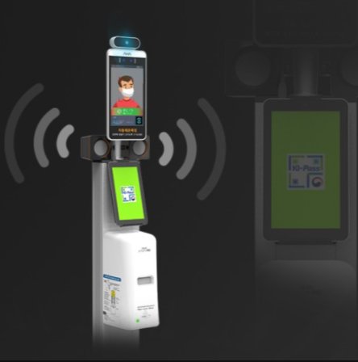
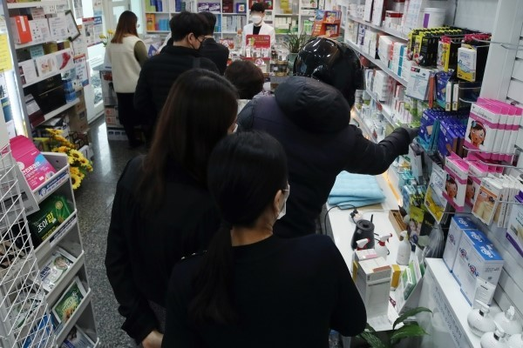
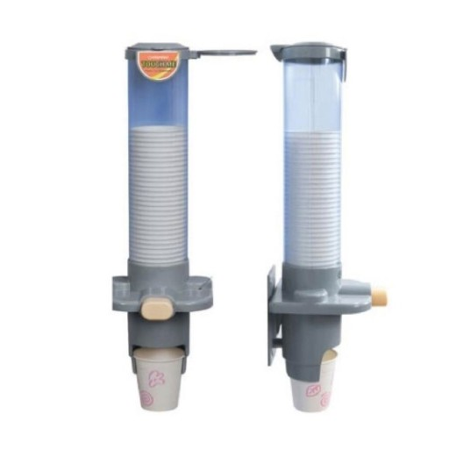
02. Value
Relative work
Practical aspects
By automatically dispensing masks, the number of people who do not have masks in the building can be reduced.
Creative aspects
In the mask supply method, it will be possible to provide one by one while the servomotor rotates by imitating the existing method of providing disposable cups for water purifiers.
https://m.blog.naver.com/PostView.nhn?blogId=wwsoptic&logNo=221392174974&proxyReferer=https:%2F%2Fwww.google.com%2F

Slide 8
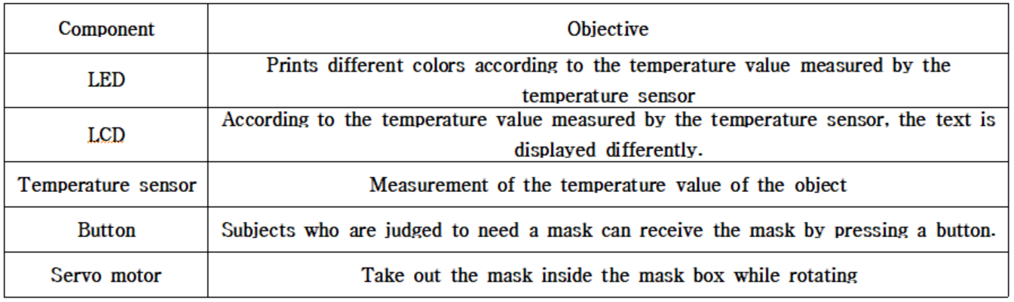
02. Hardware component

Slide 9
Feature

Slide 10
03. Pros. and Cons.
Pros.
Cons.
Reduces the number of masks in the building by automatically providing masks to those who need masks
Relatively hygienic than hand-handed
Unlike infrared measurement, the object to be measured must contact the thermometer
It is slower than the hand-passing process

Slide 11
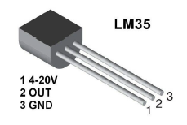
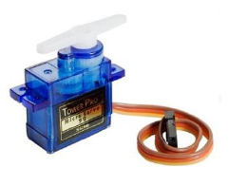
03. Special points
It is best to use an infrared sensor, but currently it is difficult to obtain an infrared sensor, and the temperature sensor that was used in class must be used.
It is questionable whether a single mask can be accurately taken out with the power of the servo motor.

Slide 12
Final

Slide 13

04. Progress
Ideation
We had 3 ideas.
MP3 player
Temperature
Cane for the blind
As a result of the vote,
we decide to do a thermometer.
Because we thought it was the most issue in these days, and it was an idea that could mobilize all the things we've learned so far.
Circuit Wiring Design
Code Sketch

Slide 14

04. Participant
허승효
박상우
백정웅
이정명
Coding
Circuit wiring
25%
Coding
Circuit wiring
25%
Coding
Presentation
25%
Coding
Making PPT
25%

Slide 15
Thank you

